Slide 1
Conceptualisation
WP2 T3

Slide 2
Learning Objectives
Compose a content concept map
Prepare a syllabus

Slide 3
Concept Map
Outline the specific components of your training
Identify relationships
Check with the defined learning objectives
Types:
Hierarchical
Spider
Flowchart
etc.

Slide 4
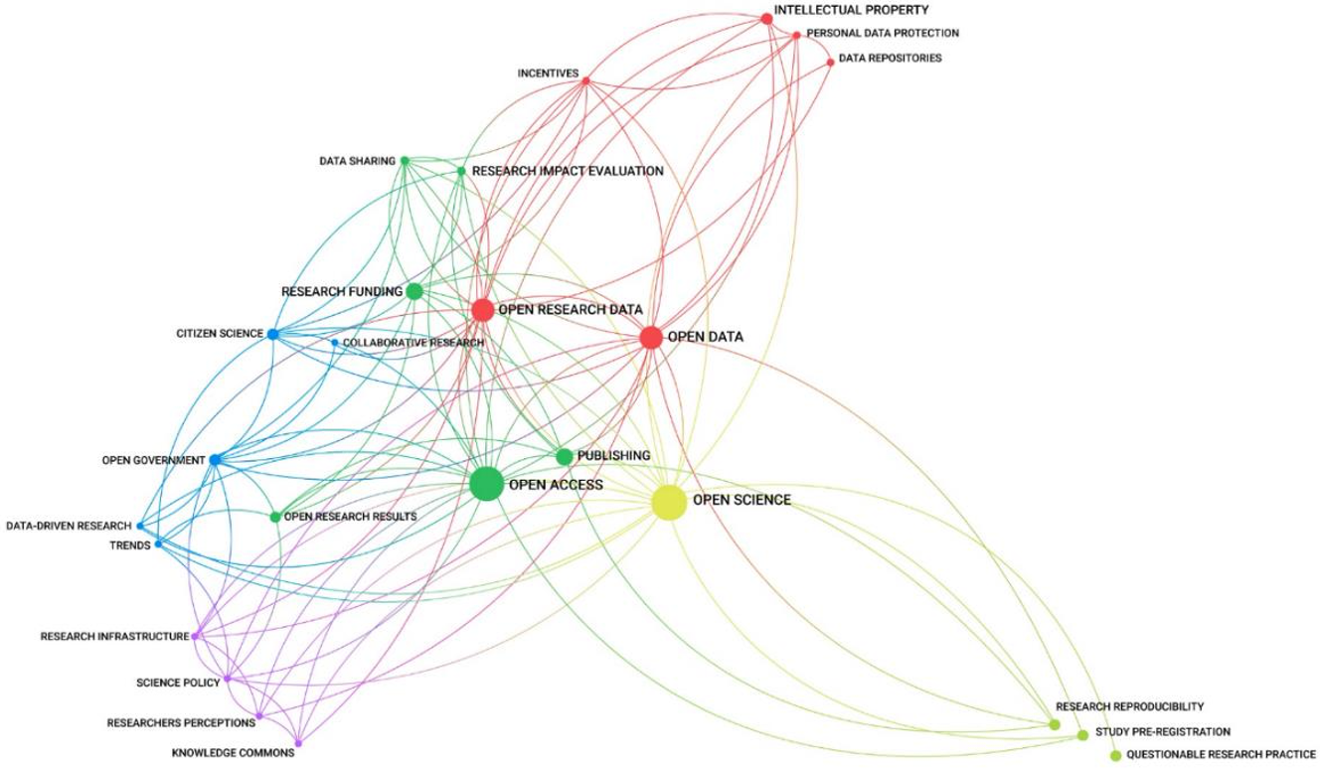
Open Science Concept Map

Slide 5
Concept mapping
Try building a concept map about your upcoming training
use any graphical tool or do it on paper
option: draw.io
category: Maps

Slide 6
Syllabus
The syllabus presents a high-level sequence outline
can be broken down into smaller subtopics later
Offers logical topics sequence
concepts introduced early help with the ones encountered later
The defined agenda should not be very rigid
Change the sequence of topics
Add or delete topics at a later stage
Should provide learners with the necessary information
help them decide if they want to follow the training
Incorporates all elements defined with the RDA minimal schema

Slide 7
Syllabus Elements
Title
Training Description
Target audience
Primary Language
Prerequisites
Duration
Certification Information
Author(s)
PID
Accessibility Mission
Type
Date/Time
Location
Expertise Level
Access Cost
Training objectives
Keywords
Agenda
Resources and Materials
Trainer(s)
Contact information
License

Slide 8
Define a Syllabus
Try to develop your own syllabus for the Open Science for policy makers training
Use the information you gathered and defined in the previous activities
use the syllabus for this training as the basis

Slide 9
Summary
Concept map
to get the creative juices flowing
Syllabus
to outline all essential information about the training in an RDA minimal schema compatible way
Next stop:
Granular learning content structure

Slide 10
Thank you! Any questions before we continue?
sonja.filiposka@finki.ukim.mk
Cite instructions on: https://doi.org/10.5281/zenodo.10716172

